Slide 1
SPARKS FOUNDATION
Task : - PAYMENT GATEWAY INTEGRATION
PRESENTED BY : BHAVIK SAGAR

Slide 2
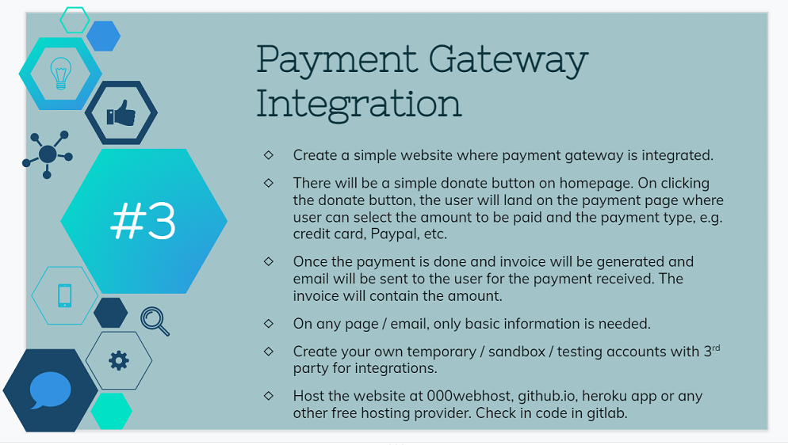

Slide 3
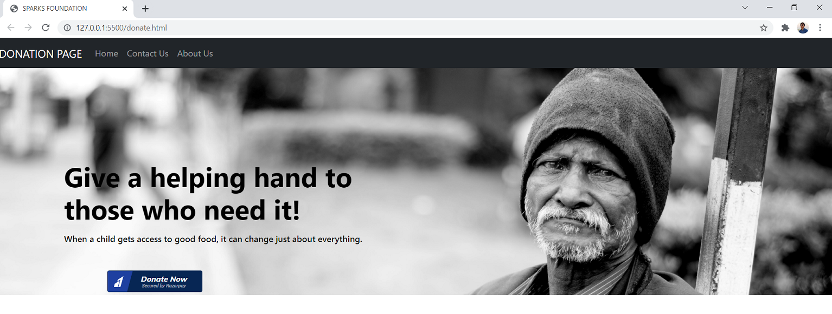
Payment Gateway integration Overview :

